Slide 1


PRESENTATION
ON
COVID AWARENESS
WEBSITE
Under the Guidance of
Mr. Anurag Malik
By
Shubham Sharma 1900820100145
Section: C, 4th Year
&
Ms. Prachi Agarwal Assistant Professor
Associate Professor

Slide 2
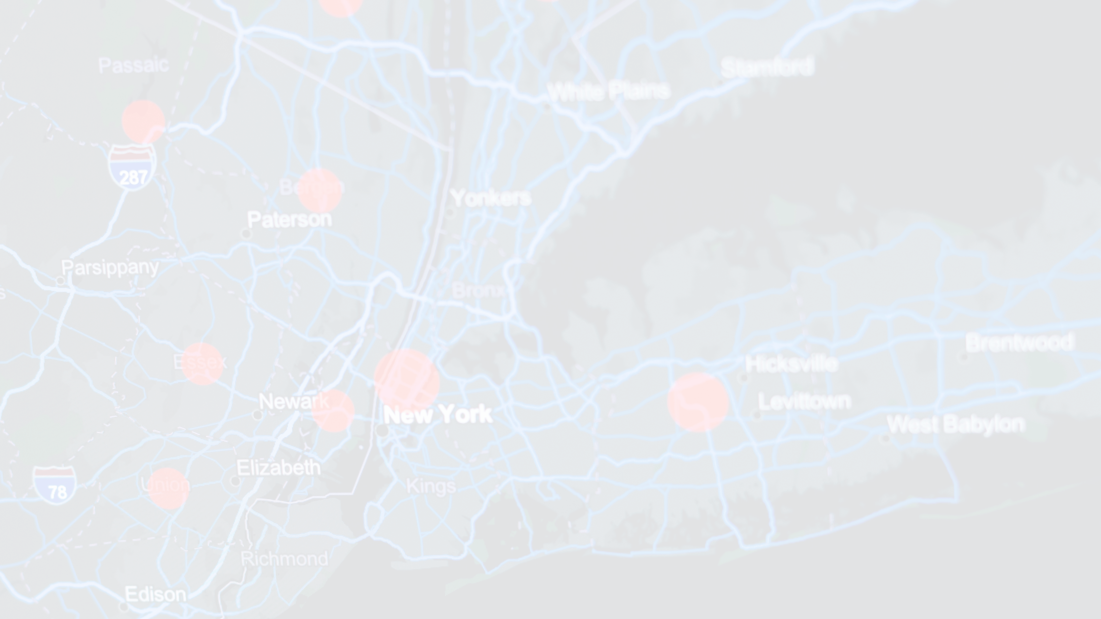

PRESENTATION ROADMAP
TOPICS WE COVER
2.
WHICH MODULES I'VE USED?
4.
HOW OUR WEBSITE LOOK LIKE?
6.
LIMITATIONS
01
02
03
04
05
06
1.
INTRODUCTION
3.
WHICH SERVER AND DATABASE I'VE USED?
5.
ADVANTAGES AND SCOPE ?

Slide 3

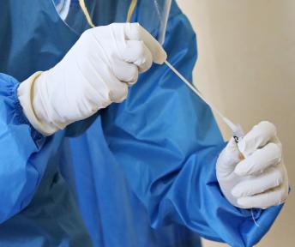

INTRODUCTION
THIS COVID AWARENESS WEBSITE PROJECT IS DESIGNED AND CREATED TO SPREAD AWARENESS TO PEOPLE AND IT HAS SOME OTHER FEATURES LIKE:
TELL THE MYTHS AND FACTS SYMPTOMS OF CORONA DISEASE PRECAUTIONS
Registration for Covid-19 Vaccine
MANY MYTHS IS CIRCULATED OVER SOCIAL MEDIA WHICH RESULT THAT SOME PEOPLE'S DEATH & BADLY HEALTH ISSUE. SO, THIS WEBSITE IS USEFUL FOR PEOPLE TO CHECK THAT THE MYTH IS TRUE OR FALSE?

Slide 4




WHICH MODULE I'VE USED?
HTML
HYPER TEXT MARKUP LANGUAGE
CSS
CASCADING STYLE SHEETS
JS
JAVASCRIPT

Slide 5

HTML
(HYPER TEXT MARKUP LANGUAGE)
The main reason why it’s important to know HTML is because it allows you as a website owner to create the basic structure of your website.

Slide 6
CSS is primarily used to create static visual effects, and alter the layout and formatting of your website.
CSS
(CASCADING STYLE SHEETS)

Slide 7
With a basic understanding of JavaScript, you can manipulate the various interactive features of your website to perform a wide range of actions.
JS
(JAVASCRIPT)

Slide 8

SERVER & DATABASE USED?
SERVER:
TOMCAT
DATABASE:
MYSQL

Slide 9

TOMCAT
It is an open-source servlet container. If you want to provide any web-services such as you want to provide a simple static content possibly by using HTML (or Hypertext Markup Language), or maybe you just want to send data from a server to point you, so you necessarily need a server and that server is HTTP(HyperText transfer protocol)

Slide 10
MYSQL
MySQL is the world’s most popular open source database. According to DB-Engines, MySQL ranks as the second- most-popular database, behind Oracle Database.
MySQL is fast, reliable, scalable, and easy to use. It was originally developed to handle large databases quickly And it support around 12 programming language like Python, Java, PHP, Perl, etc.

Slide 11
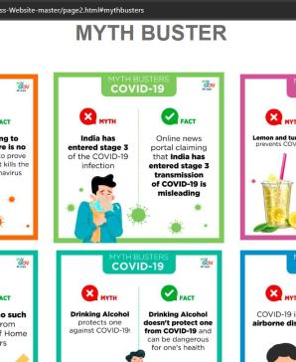
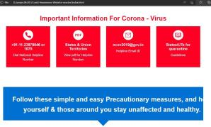
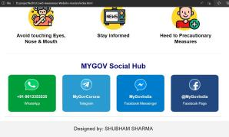
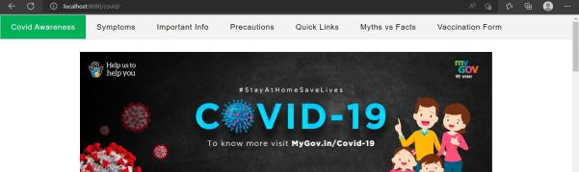
SCREENSHOTS OF WEBSITE

Slide 12
ADVANTAGE & SCOPE
EASILY SHARE UPDATES Sharing regular updates can not only attract new visitors, through tactics like search engine optimization but can keep people returning to your website and potentially inspire them to take additional actions once they’re here. | Easy to Get in Touch A website makes it possible for people to reach out and join in your efforts when they stumble across you on the web through related topics or interest in your cause
REDUCE MYTHS | Easily Registration of Covid-19 Vaccine
Through knowledge, awareness, and understanding, you are empowered to challenge negative beliefs and attitudes in others that perpetuate myths about CORONA. | You can enter your details through a form that is available on the website.

Slide 13



LIMITATIONS
YES! it has some limitations also
System Compatibility This website looks best on desktop/ laptop or big screen.
I've Short out these three (3) limitations in this website:
Network
It require some networkconnectivity to login and enter details.
Design
It has responsive design structure but need more and more functionalities and code.

Slide 14

Thank You!
Questions? Comments? Concerns?
Now discuss anything you'd like, or simply drop a message on my mail.
Name:
Shubham Sharma 1900820100145
Section: C, 4th Year
Phone:
+91- 9897448422
Email:
shubham4in@gmail.com

